Slide 1
The Physical Layer
Data Communications · Data Rate Limits, Media, Digital Transmission & Line Coding

Slide 2
Section 1
Data Rate Limits

Slide 3
Data Rate Limits
A key question in data communications: how fast can we send data (in bits per second) over a channel?
Data rate depends on three factors:
  1. The bandwidth available
  2. The number of signal levels we use
  3. The quality of the channel (the level of noise)
Two governing limits: the Nyquist Bit Rate (noiseless channel) and the Shannon Capacity (noisy channel).

Slide 4
Capacity of a System
The bit rate of a system increases as we increase the number of signal levels used to represent a symbol.
A symbol can consist of a single bit, or of n bits — giving 2ⁿ possible signal levels.
As the number of levels increases, the spacing between levels shrinks — increasing the probability of error.
Increasing signal levels boosts data rate, but reduces reliability. There's always a trade-off.

Slide 5
Nyquist Theorem — Noiseless Channel
Nyquist gives the upper bound on bit rate for a noiseless channel, based on bandwidth and the number of signal levels.
Assumes 2 symbols per cycle and the first harmonic.
Bit Rate = 2 × Bandwidth × log₂(L)
L = number of signal levels used to represent data.

Slide 6
Example 1 & 2: Applying Nyquist
A noiseless channel has a bandwidth of 3000 Hz.
With 2 signal levels: Bit Rate = 2 × 3000 × log₂(2) = 6000 bps.
With 4 signal levels (2 bits/level): Bit Rate = 2 × 3000 × log₂(4) = 12,000 bps.
More signal levels → higher bit rate, for the same bandwidth

Slide 7
Example 4: Solving for Signal Levels
Problem: send 265 kbps over a noiseless channel with 20 kHz bandwidth. How many signal levels are needed?
Using the Nyquist formula: 265,000 = 2 × 20,000 × log₂(L) → L ≈ 6.4 → L = 2⁶·⁴
Since this isn't a power of 2, we must adjust:
  128 levels → bit rate becomes 280 kbps
  64 levels → bit rate becomes 240 kbps

Slide 8
Shannon's Theorem — Noisy Channel
Shannon's theorem gives the channel capacity in the presence of noise, based on the signal-to-noise ratio (SNR).
C = B × log₂(1 + SNR)
B = bandwidth in Hz. A higher SNR allows a higher theoretical capacity.

Slide 9
Examples 5–8: Applying Shannon
Extremely noisy channel (SNR ≈ 0): capacity C = 0, regardless of bandwidth — no data can get through.
Telephone line (B = 3000 Hz, SNR = 3162): theoretical highest bit rate ≈ 34.86 kbps.
When SNR is very high, SNR + 1 ≈ SNR, simplifying to C ≈ B × log₂(SNR).
In practice: Shannon gives the theoretical upper limit; Nyquist then tells us how many signal levels are needed to achieve a chosen rate below that limit.

Slide 10
Section 2
Network Performance

Slide 11
Network Performance
Performance is a key measure of how good a network really is — closely tied to Quality of Service (QoS).
Four key terms:
  Bandwidth — the capacity of the system
  Throughput — the actual rate of successful data delivery
  Latency (Delay) — the delay a bit experiences from start to finish
  Bandwidth-Delay Product — how much data can "fill" the link

Slide 12
Bandwidth: Two Meanings
In networking, "bandwidth" is used in two different contexts:
Bandwidth in hertz:
  The range of frequencies in a composite signal, or that a channel can pass.
Bandwidth in bits per second:
  The speed of bit transmission in a channel — how fast data actually moves.

Slide 13
Example 9: Throughput
A 10 Mbps network passes an average of 12,000 frames/minute, each carrying 10,000 bits. What's the throughput?
Throughput = (12,000 × 10,000) / 60 = 2,000,000 bps = 2 Mbps
Throughput = 2 Mbps
The throughput here is only about one-fifth of the available bandwidth.

Slide 14
Propagation vs. Transmission Delay
Propagation speed: how fast a signal physically travels through the medium, from source to destination.
Transmission speed: how long it takes for all the bits in a message to be pushed onto the link.
Propagation Delay = Distance / Propagation Speed
Transmission Delay = Message Size / Bandwidth
Latency = Propagation Delay + Transmission Delay + Queueing Time + Processing Time

Slide 15
Examples 10–12: Delay in Practice
Distance of 12,000 km, propagation speed 2.4×10⁸ m/s → propagation time ≈ 50 ms.
  A bit can cross the Atlantic in just 50 ms over a direct cable.
2.5 KB email, 1 Gbps link, same distance: propagation time dominates — transmission time is negligible.
5 MB image, 1 Mbps link, same distance: transmission time dominates — propagation time is negligible.
Rule of thumb: short messages on fast links → propagation-dominated. Large messages on slow links → transmission-dominated.

Slide 16
Bandwidth-Delay Product
Think of the link between two points as a pipe:
  The cross-section of the pipe represents the bandwidth.
  The length of the pipe represents the delay.
  The volume of the pipe is the bandwidth-delay product.
The bandwidth-delay product defines the number of bits that can fill the link at any one time — a key factor in network buffering and flow control.

Slide 17
Section 3
Transmission Media

Slide 18
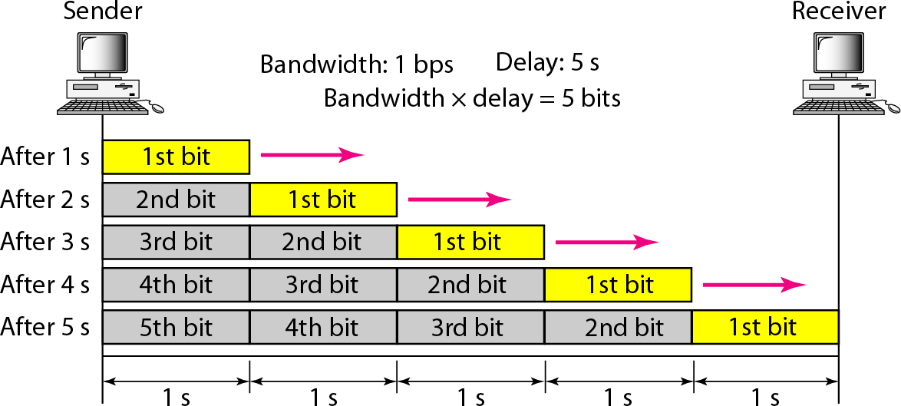
Transmission Media & the Physical Layer
A transmission medium is loosely defined as anything that can carry information from a source to a destination.
Transmission media sit below the physical layer and are directly controlled by it.
Two broad classes:
  Guided media — twisted-pair, coaxial, and fiber-optic cable
  Unguided media — wireless transmission through air/space (radio, microwave, infrared)

Slide 19
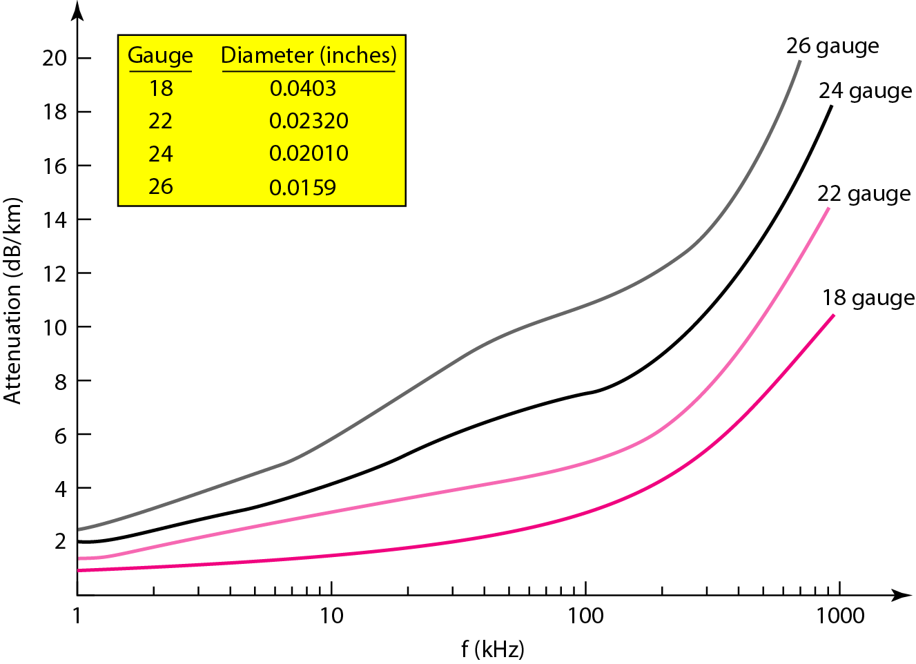
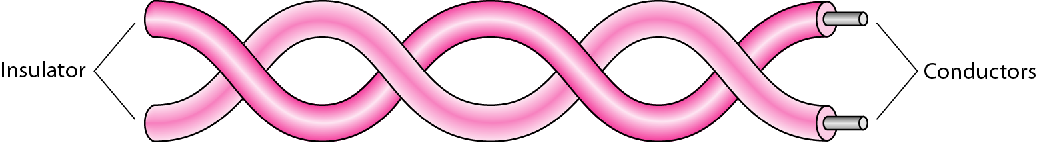
Guided Media: Twisted-Pair Cable
Two insulated copper wires, twisted together to reduce electromagnetic interference.
UTP (Unshielded) — cheaper, more common. STP (Shielded) — adds a metal foil for extra noise immunity.
UTP is graded into categories (e.g. Cat 3 through Cat 6+) — higher categories support higher data rates.
Terminated with RJ-45 connectors. Performance depends heavily on cable category, length, and installation.

Slide 20
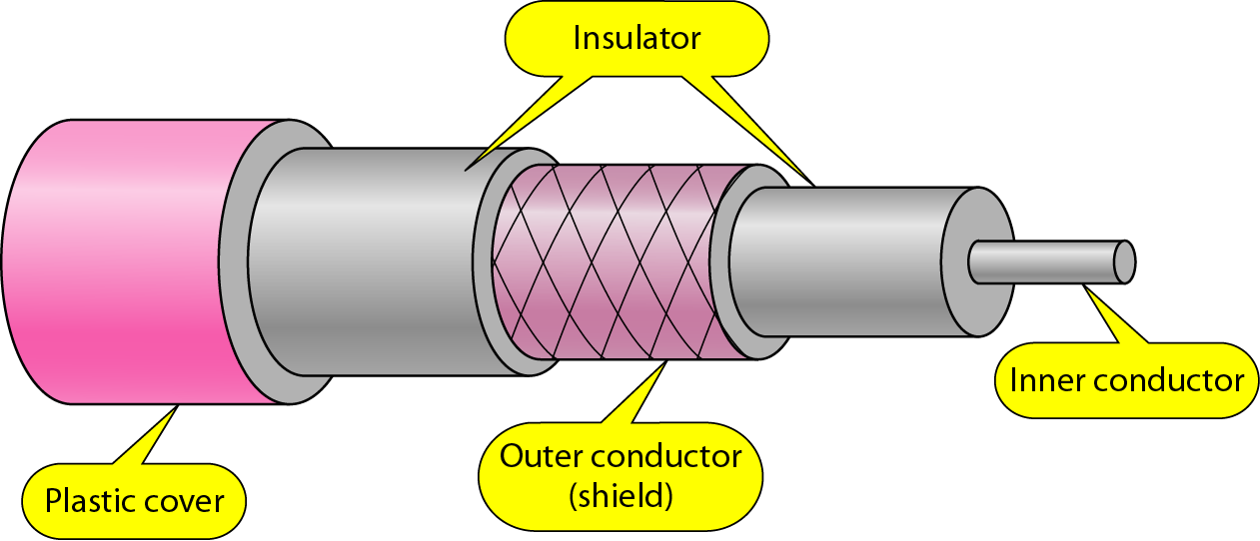
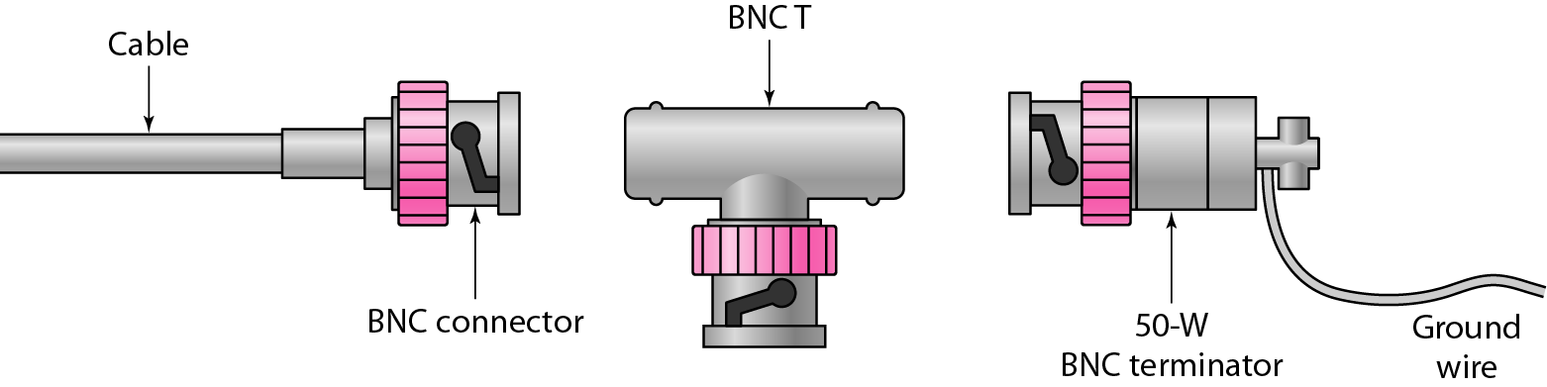
Guided Media: Coaxial Cable
A single copper core conductor, surrounded by insulation, a metallic shield, and an outer jacket.
The shielding gives coaxial cable much better noise immunity than twisted pair.
Categorized by RG rating (e.g. RG-59, RG-6) for different applications (cable TV, baseband networking).
Terminated using BNC connectors — supports higher bandwidth over longer distances than UTP.

Slide 21
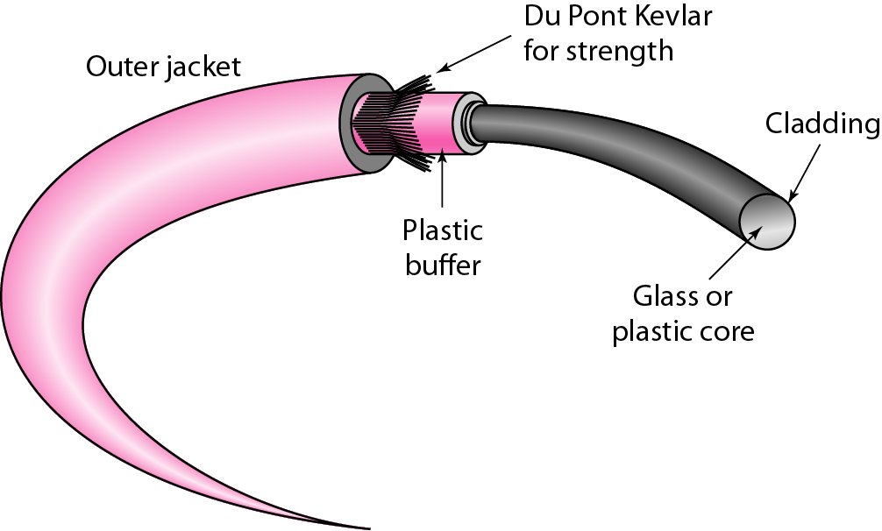
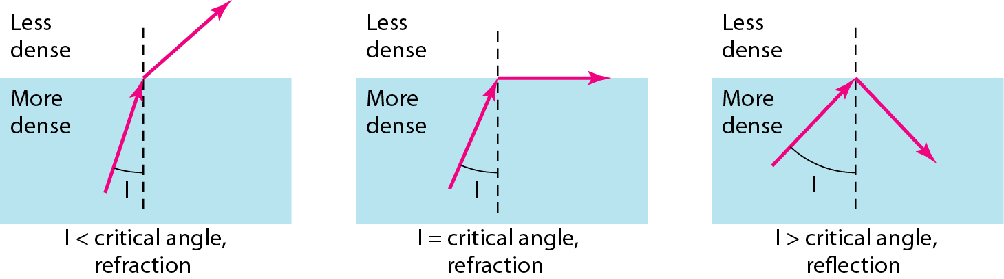
Guided Media: Fiber-Optic Cable
Transmits data as pulses of light through thin glass or plastic fiber.
Light is kept within the core through total internal reflection, bending along the length of the fiber.
Construction: a core, surrounded by cladding, a buffer, and an outer jacket.
Offers very high bandwidth and long distance, with strong immunity to electromagnetic interference.
Terminated with connectors such as SC and ST.

Slide 22
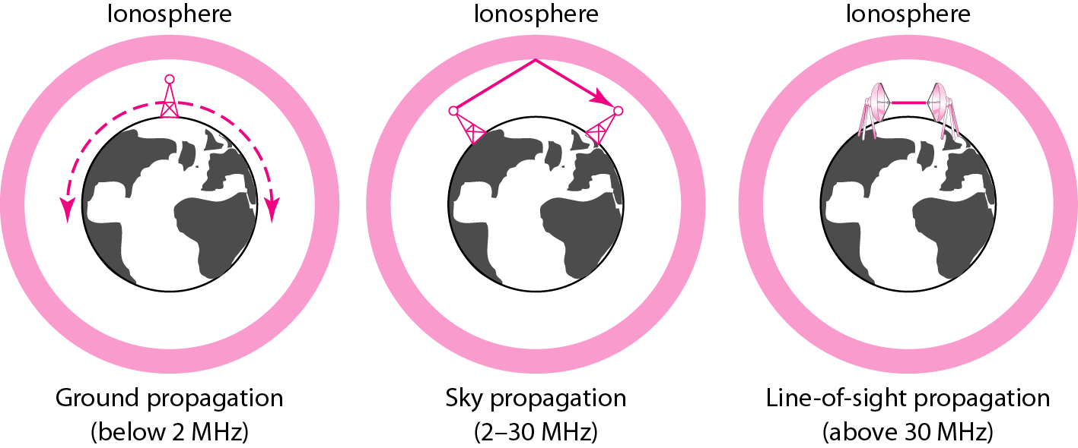
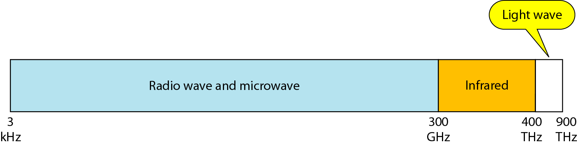
Unguided Media: Wireless Communication
Unguided media transport electromagnetic waves without a physical conductor — wireless communication.
Three main frequency bands:
  Radio Waves — omnidirectional, penetrate walls, used for broadcast
  Microwaves — directional, line-of-sight, used for point-to-point links
  Infrared — very short range, blocked by walls, line-of-sight only

Slide 23
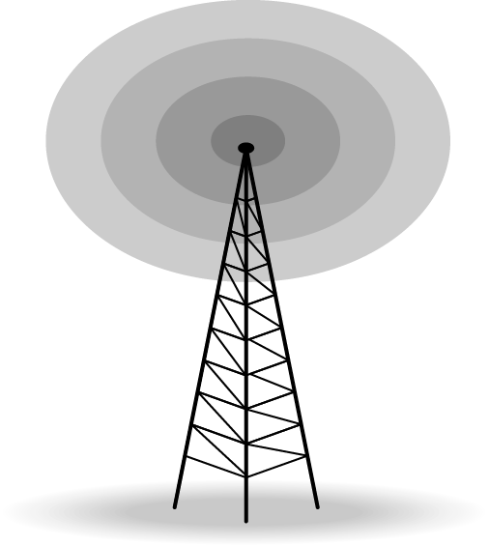
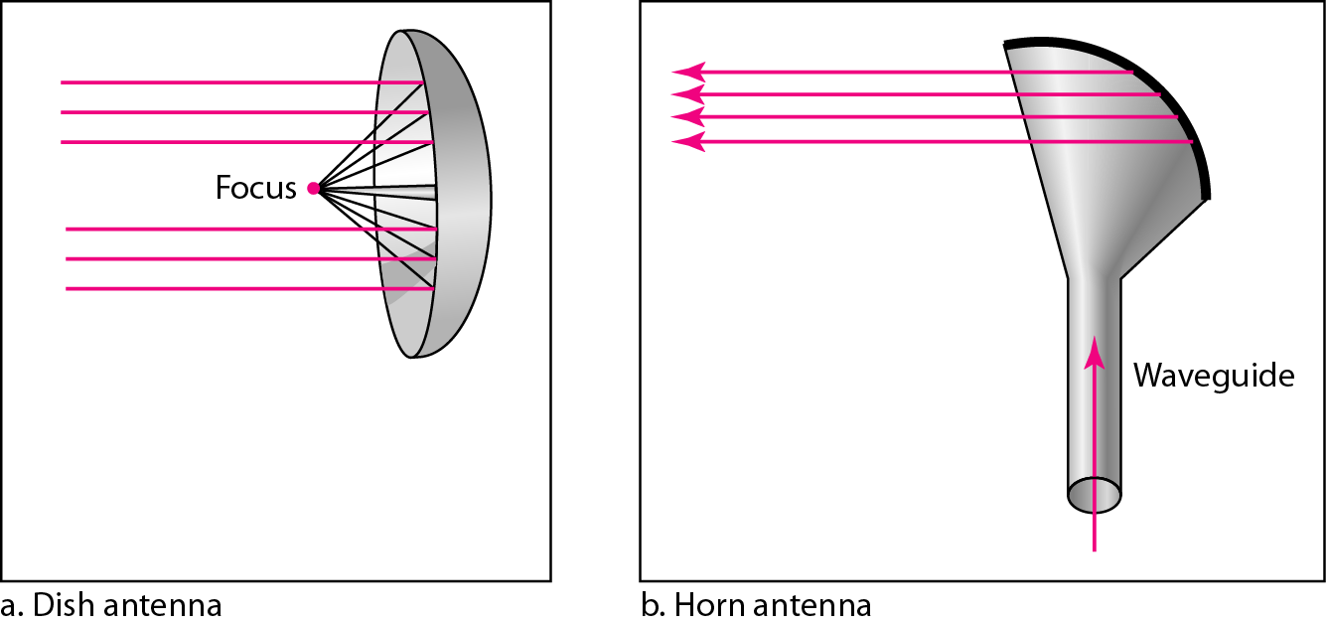
Radio Waves & Microwaves
Radio Waves
Microwaves
Used for multicast communication: radio, TV, paging systems
Can penetrate through walls
Highly regulated by spectrum authorities
Use omnidirectional antennas
Used for unicast communication: cellular, satellite, wireless LANs
Higher frequencies cannot penetrate walls
Use directional antennas for point-to-point, line-of-sight links

Slide 24
Infrared & Wireless Channel Challenges
Infrared:
  Used for short-range communication in a closed area, using line-of-sight propagation.
Wireless channels are subject to far more errors than guided media:
  Interference is a major cause of errors — mitigated with a higher SNR.
  But a higher SNR means less capacity is available, due to the broadcast nature of the channel.
  Channels are also subject to fading and coverage holes.

Slide 25
Section 4
Digital Signals

Slide 26
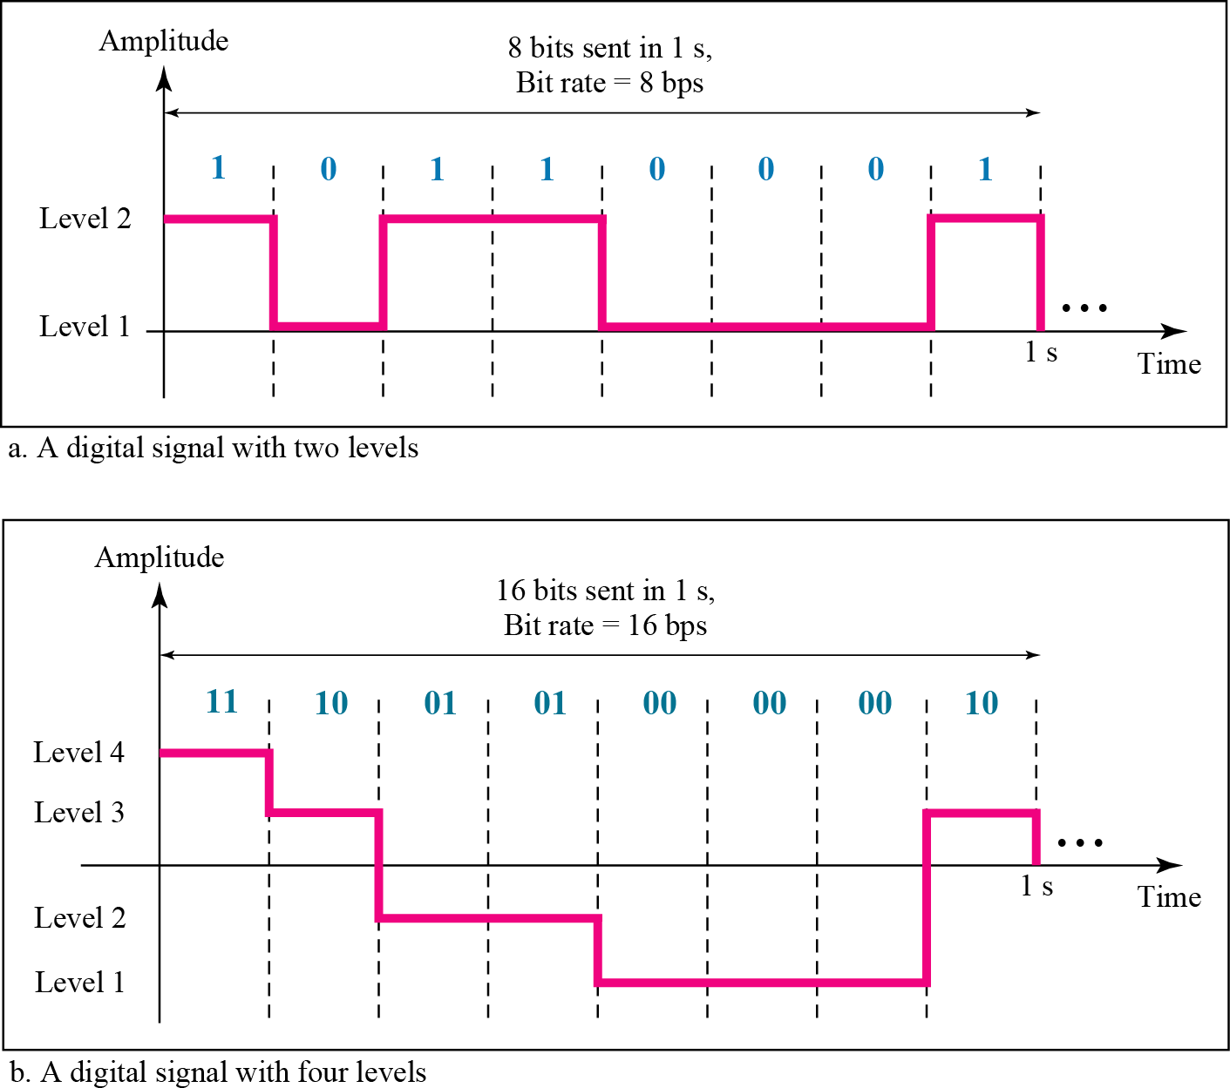
Digital Signals
Besides analog signals, information can also be represented by a digital signal.
Example: a binary 1 encoded as a positive voltage, a binary 0 as zero voltage.
A digital signal can have more than two levels — in which case each level represents more than 1 bit.

Slide 27
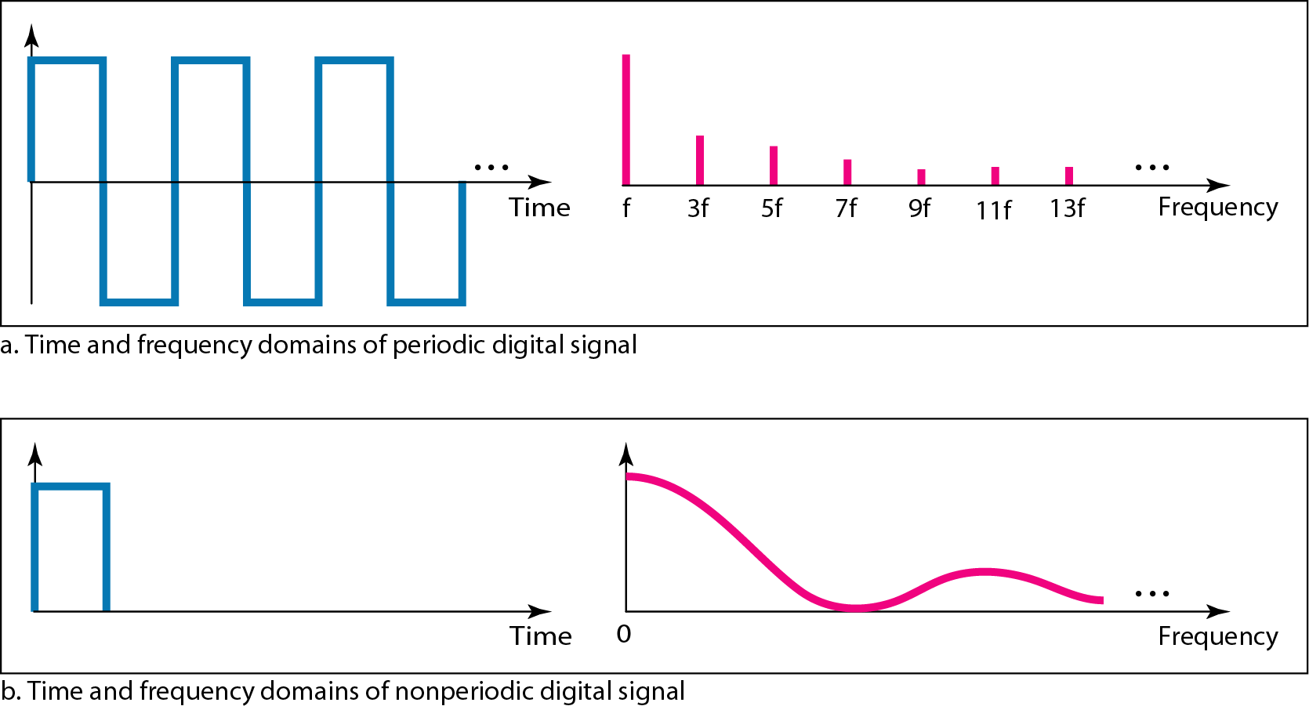
Example 14: Bits per Level
A digital signal has eight levels. How many bits are needed per level?
We use: number of bits = log₂(number of levels) = log₂(8) = 3
Each signal level is represented by 3 bits.

Slide 28
Digital Signal Bandwidth
A digital signal is, mathematically, a composite analog signal made up of an infinite number of frequencies — so it has infinite bandwidth.
In practice, the effective bandwidth of a digital signal is finite: most of the signal's energy is concentrated in a limited frequency range.
This is why we can still transmit digital signals over real (band-limited) channels.

Slide 29
Section 5
Digital-to-Digital Conversion: Line Coding

Slide 30
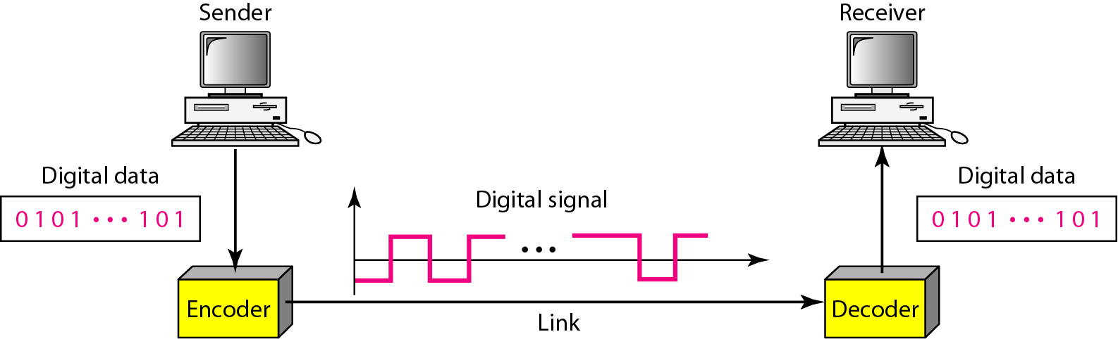
Line Coding
Line coding converts a string of 1s and 0s (digital data) into a sequence of signals.
Example: a high voltage (+V) could represent "1", a low voltage (0 or -V) could represent "0".
Digital-to-digital conversion involves three techniques:
  Line coding — always needed
  Block coding — may or may not be needed
  Scrambling — may or may not be needed

Slide 31
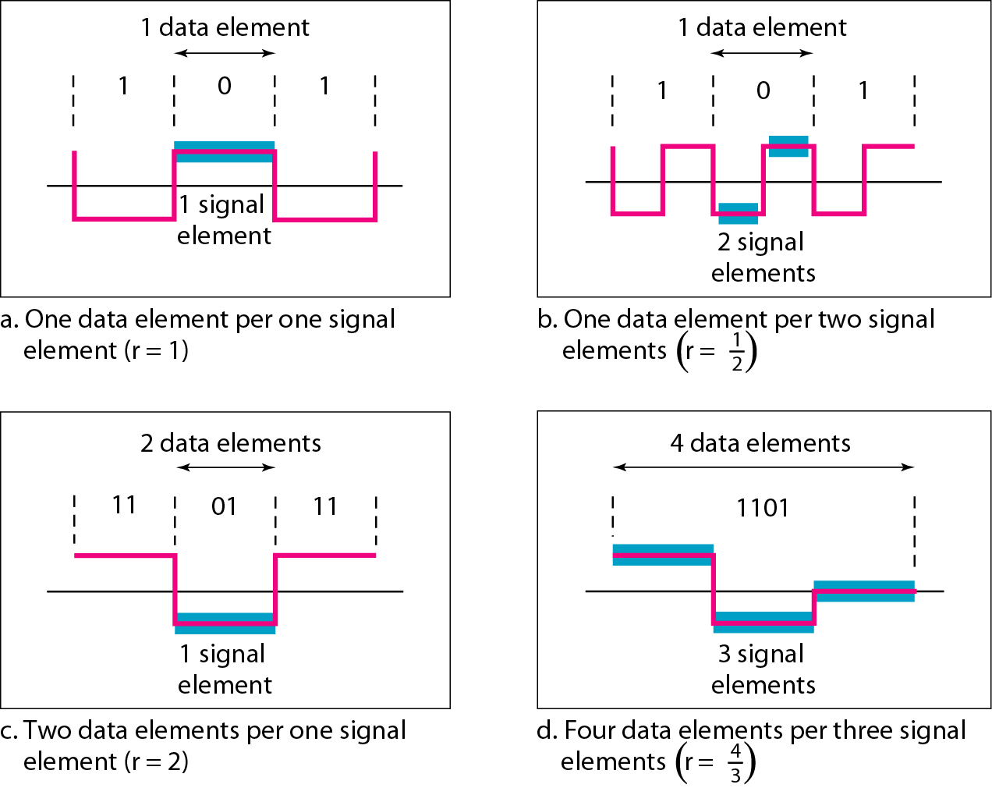
Data Rate vs. Signal Rate
Data rate (bit rate): the number of bits sent per second (bps).
Signal rate (baud rate / modulation rate): the number of signal elements sent per second.
A data symbol can be coded into a single signal element, or multiple signal elements.
The goal of good line coding: increase the data rate while keeping the baud (signal) rate as low as possible.

Slide 32
Example 15: Baud Rate
One data element per signal element (r = 1). Bit rate = 100 kbps. What's the average baud rate?
S = c × N × (1/r), assuming average case factor c = 1/2
S = 1/2 × 100,000 × 1 = 50,000 baud

Slide 33
What Makes a Good Line Encoding?
Baseline wandering — the receiver tracks average signal power (the baseline) to interpret incoming bits; a signal with too little variation causes the baseline to drift, leading to errors.
DC components — a constant voltage over long periods raises low-frequency energy, which bandpass channels may not support.
Self-synchronization — sender and receiver clocks must stay aligned to the same bit interval, or the bit stream gets misread.
Error detection, noise immunity, and implementation complexity are also important design considerations.

Slide 34
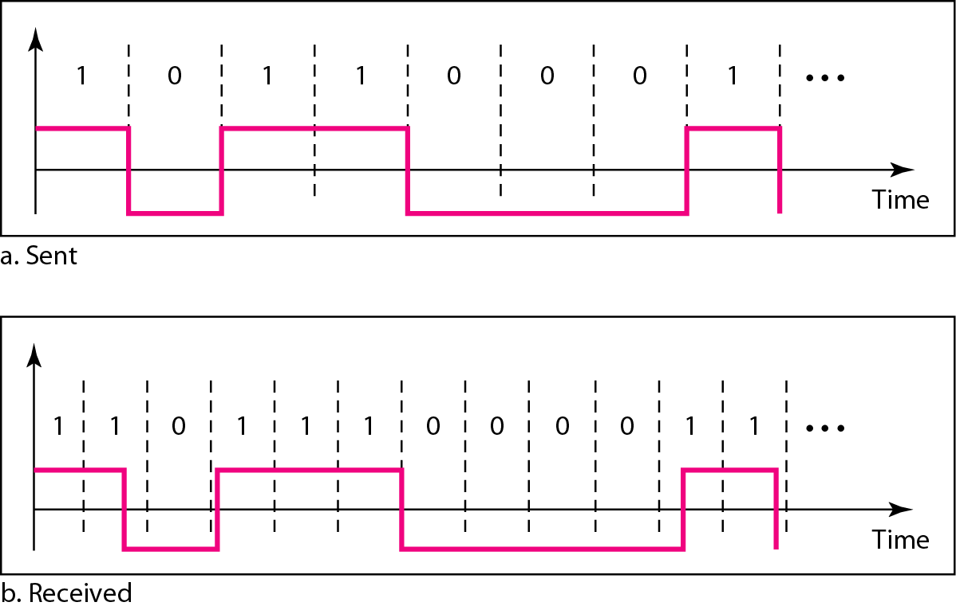
Example 17: Effect of Clock Drift
The receiver clock is 0.1% faster than the sender clock. How many extra bits/sec at 1 kbps? At 1 Mbps?
At 1 kbps: the receiver receives 1001 bps instead of 1000 bps.
At 1 Mbps: the receiver receives 1,001,000 bps instead of 1,000,000 bps.
This shows why self-synchronization matters — small clock differences compound at higher data rates.

Slide 35
Line Coding Schemes: Overview
Unipolar — all signal levels on one side of the time axis (e.g. NRZ).
Polar — voltages on both sides of the time axis (NRZ-L, NRZ-I, RZ, Manchester, Differential Manchester).
Bipolar (Multilevel) — uses three or more voltage levels (AMI, Pseudoternary, 2B1Q, 8B6T).
We'll walk through each family and its trade-offs next.

Slide 36
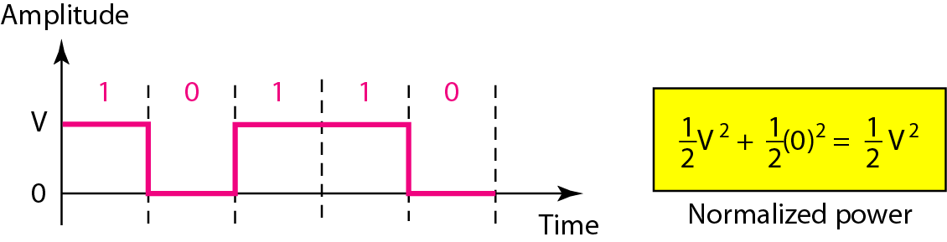
Unipolar Scheme: NRZ
All signal levels are on one side of the time axis — either above or below.
NRZ (Non-Return-to-Zero): the signal level does not return to zero during a symbol transmission.
Prone to baseline wandering and DC components.
Has no self-synchronization and no error-detection capability.

Slide 37
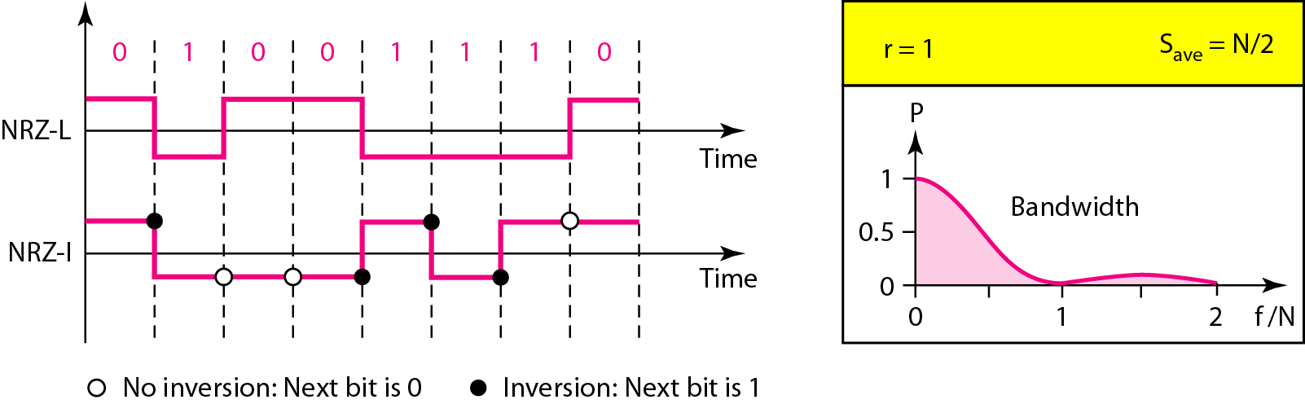
Polar Schemes: NRZ-L and NRZ-I
Voltages appear on both sides of the time axis — typically +V for 1, -V for 0.
NRZ-L (Level): the polarity of the voltage directly determines the bit value.
NRZ-I (Inversion): a transition (or lack of one) at the start of the bit determines the value — a "1" inverts the polarity, a "0" does not. This is differential encoding.
Both schemes have an average signal rate of N/2 baud, no self-synchronization, and no error detection.
NRZ-L has a worse DC-component / baseline-wandering problem than NRZ-I.

Slide 38
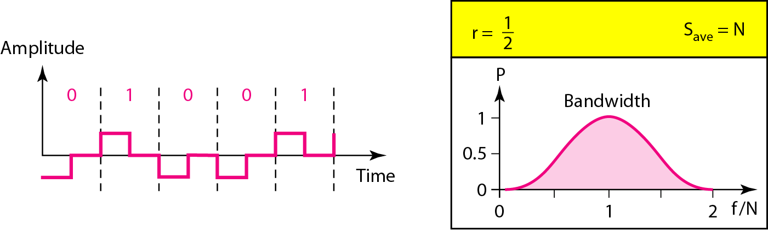
Polar Scheme: RZ (Return-to-Zero)
Uses three voltage values: +, 0, and −.
Every symbol has a transition in the middle — either high-to-zero or low-to-zero.
Two transitions per symbol means RZ needs a wider bandwidth than NRZ.
Benefit: no DC component and no baseline wandering, since the signal always returns to zero.

Slide 39
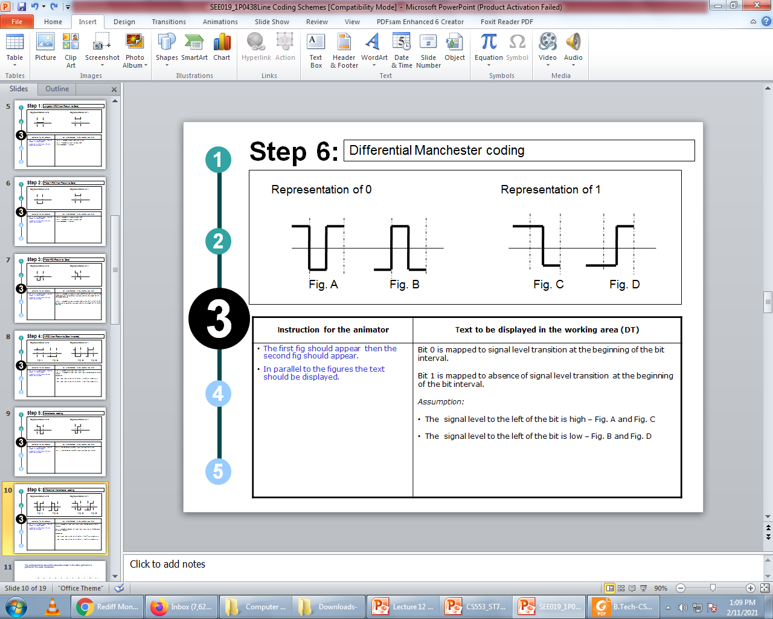
Polar Biphase: Manchester Encoding
Manchester = combines NRZ-L and RZ. Every bit has a transition in the middle (high-to-low or low-to-high).
  Used by IEEE 802.3 (classic Ethernet).
Differential Manchester = combines NRZ-I and RZ. The mid-bit transition is for clocking only; a transition at the start of the bit period represents 0, no transition represents 1.
In both schemes, the mid-bit transition also provides synchronization — no separate DC problem.
Minimum bandwidth required is double that of NRZ.

Slide 40
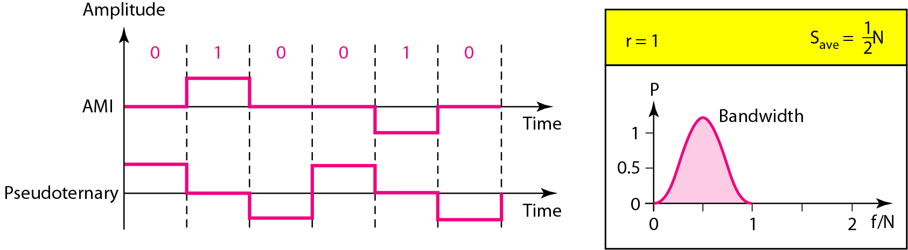
Bipolar Schemes: AMI & Pseudoternary
Bipolar schemes use three voltage levels: +, 0, and − (but unlike RZ, not as returns-to-zero).
AMI (Alternate Mark Inversion):
  Binary 0 is a neutral zero voltage.
  Binary 1s alternate between positive and negative voltages.
Pseudoternary is a variation that reverses this rule (1 = zero, 0 alternates).

Slide 41
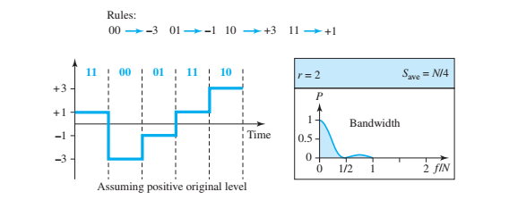
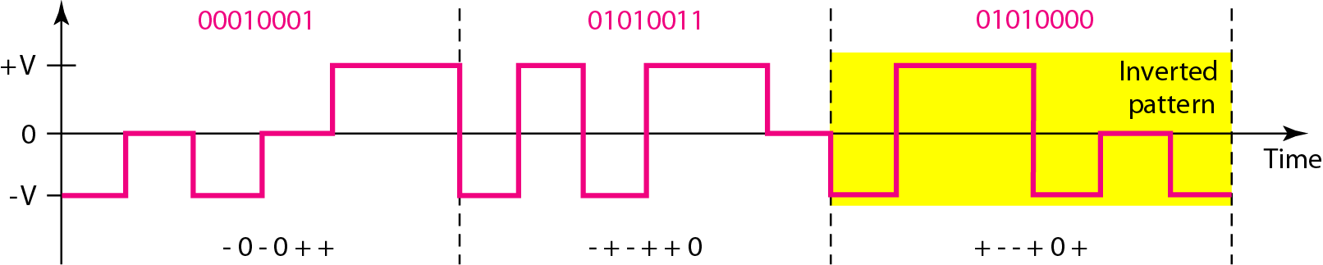
Multilevel Schemes: 2B1Q & 8B6T
The goal: increase data rate (or reduce required bandwidth) by encoding m data bits into n signal elements.
2B1Q (Two Binary, One Quaternary):
  Encodes 2-bit patterns as one 4-level (quaternary) signal element — m=2, n=1, L=4.
8B6T (Eight Binary, Six Ternary):
  Encodes 8-bit patterns as six 3-level (ternary) signal elements — used with 100BASE-T4 cable.

Slide 42
Section 6
Block Coding & Scrambling

Slide 43
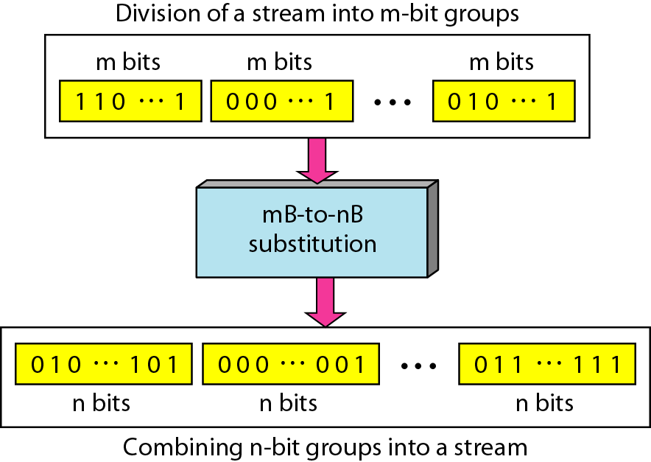
Block Coding
For a code to support error detection, we need redundancy — extra bits added to the data.
Synchronization also requires redundancy — signal transitions must occur frequently.
Block coding happens in three steps: division, substitution, and combination.
Normally referred to as mB/nB coding — it replaces each m-bit group with an n-bit group (n > m).

Slide 44
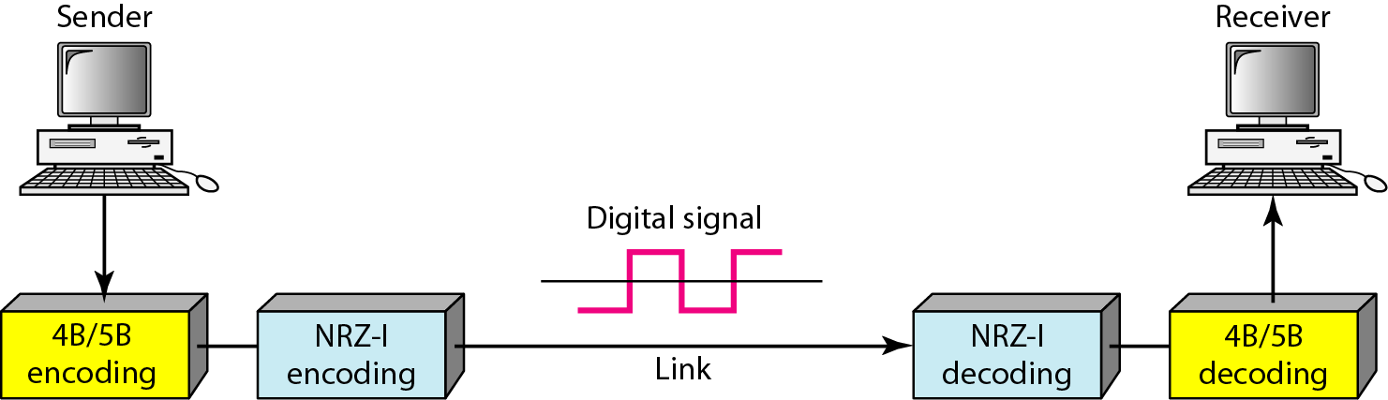
4B/5B Block Coding
4B/5B was designed to be used together with NRZ-I line coding.
Problem: a long run of 0s in NRZ-I can make the receiver's clock lose synchronization.
Solution: before NRZ-I encoding, replace every 4-bit group with a 5-bit group chosen to avoid long runs of zeros.
This is the most widely used example of block coding.

Slide 45
Scrambling
Biphase schemes (like Manchester) need too much bandwidth for long-distance links.
Block coding + NRZ isn't suitable either, due to DC-component issues over long distances.
Scrambling is the alternative: it substitutes long runs of zero-level pulses with a recognizable pattern of other levels — without increasing the number of bits.
It's applied on the fly, as part of encoding — replacing "unfriendly" bit runs with a violation code the receiver can recognize and remove.

Slide 46
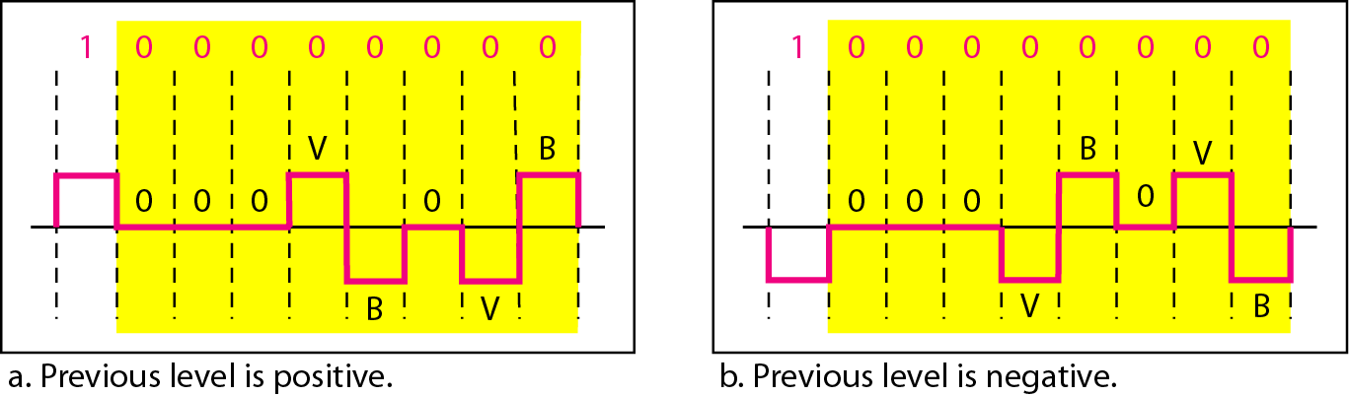
B8ZS — Bipolar with 8-Zero Substitution
Commonly used in North America.
Eight consecutive zero-level voltages are replaced by the sequence: 000VB0VB
  V = Violation — a nonzero voltage that breaks the normal AMI encoding rule.
  B = Bipolar — follows the standard bipolar (AMI) encoding rule.
This substitution both maintains synchronization and lets the receiver detect and reverse the substitution.

Slide 47
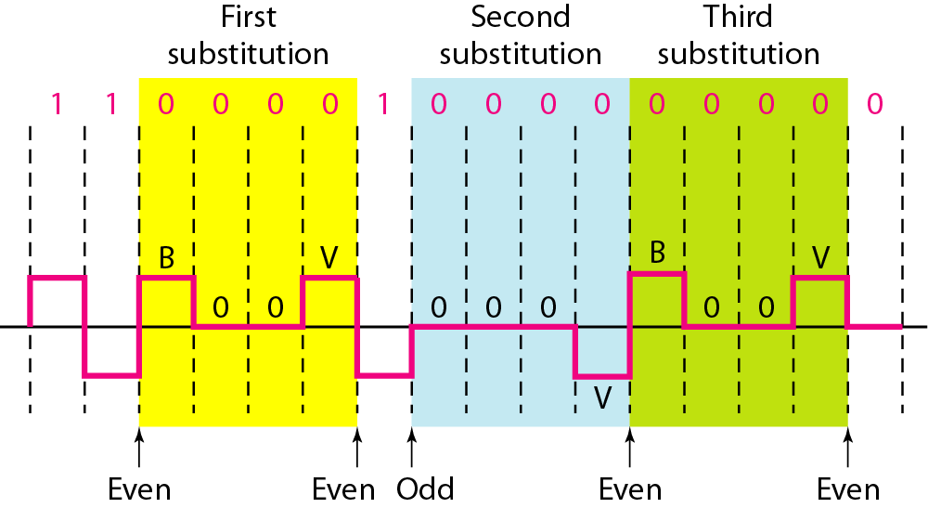
HDB3 — High-Density Bipolar 3-Zero
A more conservative alternative to B8ZS.
Four consecutive zero-level voltages are replaced with either 000V or B00V.
The choice depends on maintaining an even number of nonzero pulses after each substitution:
  If the count of nonzero pulses so far is even → substitute B00V
  If the count of nonzero pulses so far is odd → substitute 000V

Slide 48
Physical Layer: Key Takeaways
Data rate is bounded by bandwidth and signal levels (Nyquist), and further limited by noise (Shannon).
Real network performance is shaped by bandwidth, throughput, latency, and the bandwidth-delay product.
Guided media (twisted-pair, coax, fiber) and unguided media (radio, microwave, infrared) each trade off cost, bandwidth, and range differently.
Digital data is converted to digital signals via line coding — with block coding and scrambling added to improve synchronization and reduce DC/bandwidth issues.

